Slide 1
TASK 4: DASHBOARD DESIGN
Sales & Financial Performance Dashboard Name: Isha Mukherjee Tool: Power BI

Slide 2
Objective
Content:
To design an interactive dashboard for analyzing sales and financial performance using Power BI.
Key Objectives:
Track sales and profit performance
Monitor sales growth
Analyze trends over time
Compare categories, regions and segments
Provide interactive filtering

Slide 3
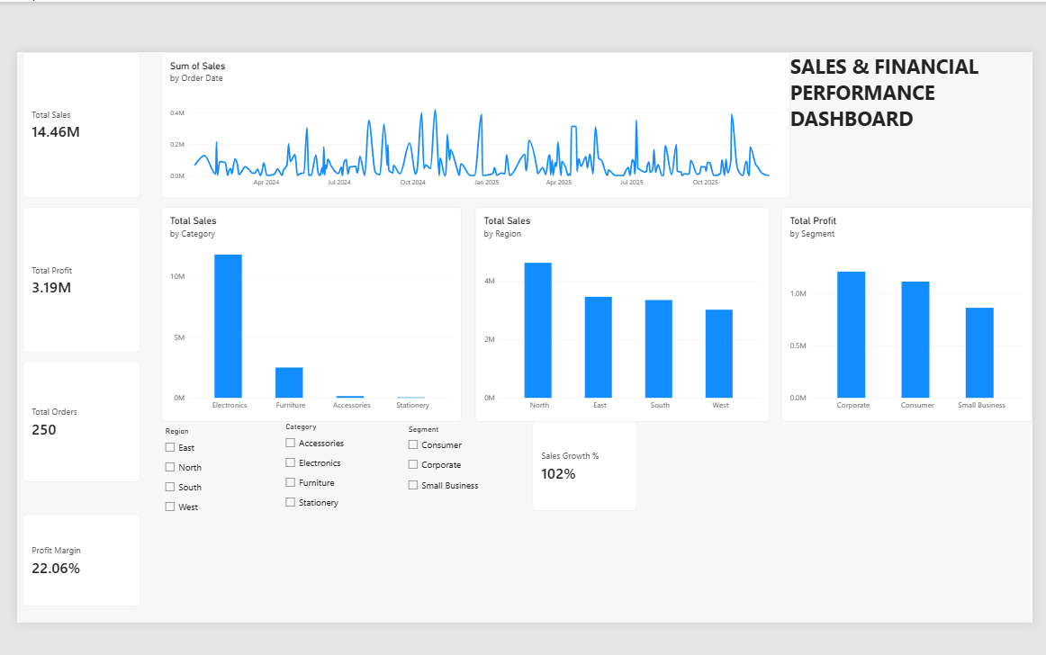
Interactive Dashboard

Slide 4
KPI Summary
Key Performance Indicators
Total Sales: 14.46M
Total Profit: 3.19M
Total Orders: 250
Profit Margin: 22.06%
Sales Growth: 102%
Analysis:
Sales trend over time
Sales by category
Sales by region
Profit by segment
Interactive slicers
PIs & Analysis

Slide 5
Conclusion
The interactive dashboard provides a clear overview of sales and financial performance. It helps analyze sales trends, category performance, regional performance and segment profitability, supporting data-driven business decisions.

